Slide 1
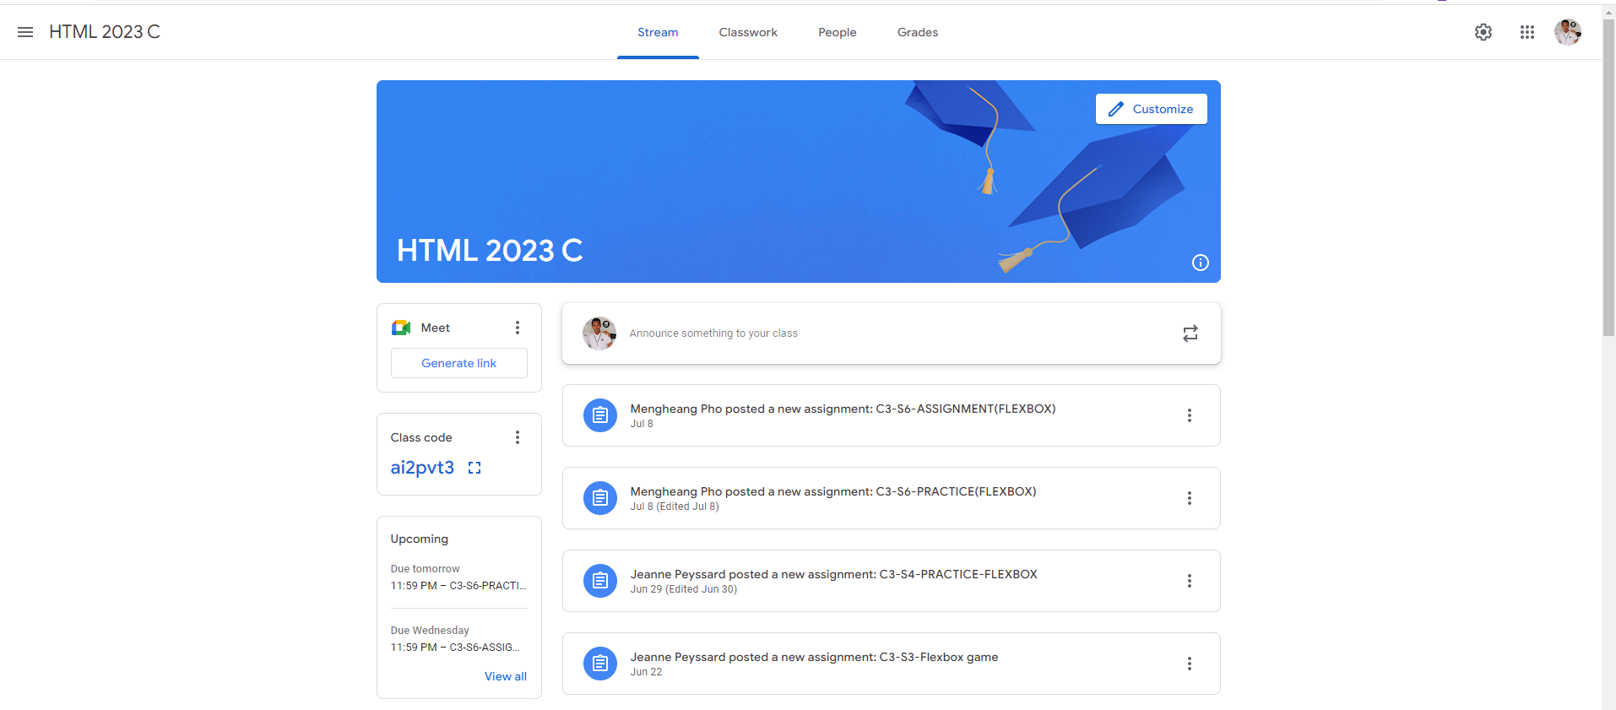
Identify root components of website below

Slide 2
Navigation
Header
Main

Slide 3
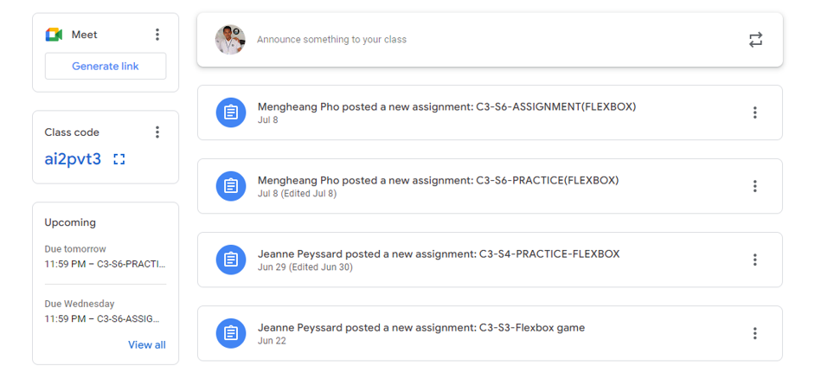
Main-Sidebar
Main-Content

Slide 4
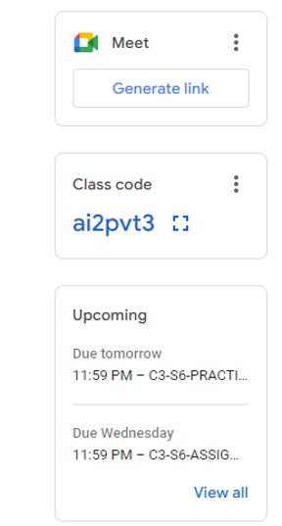
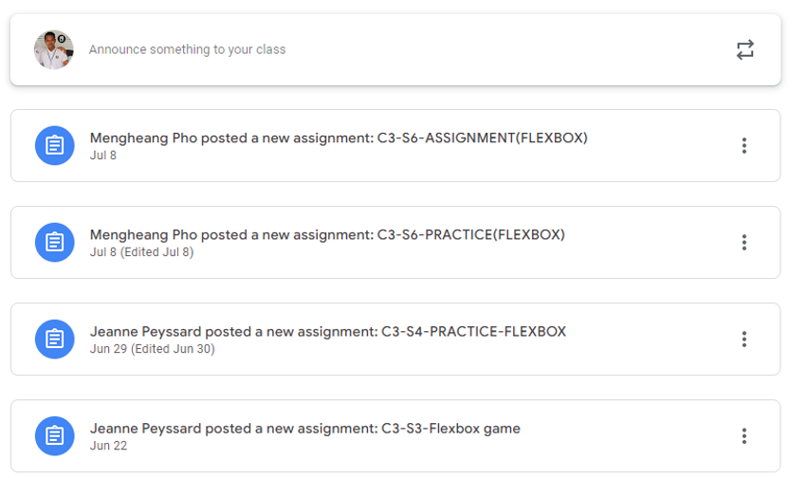
Meet
Announcement
Announcement
Class Code
Announcement
Upcoming
Announcement
Announcement

Slide 5
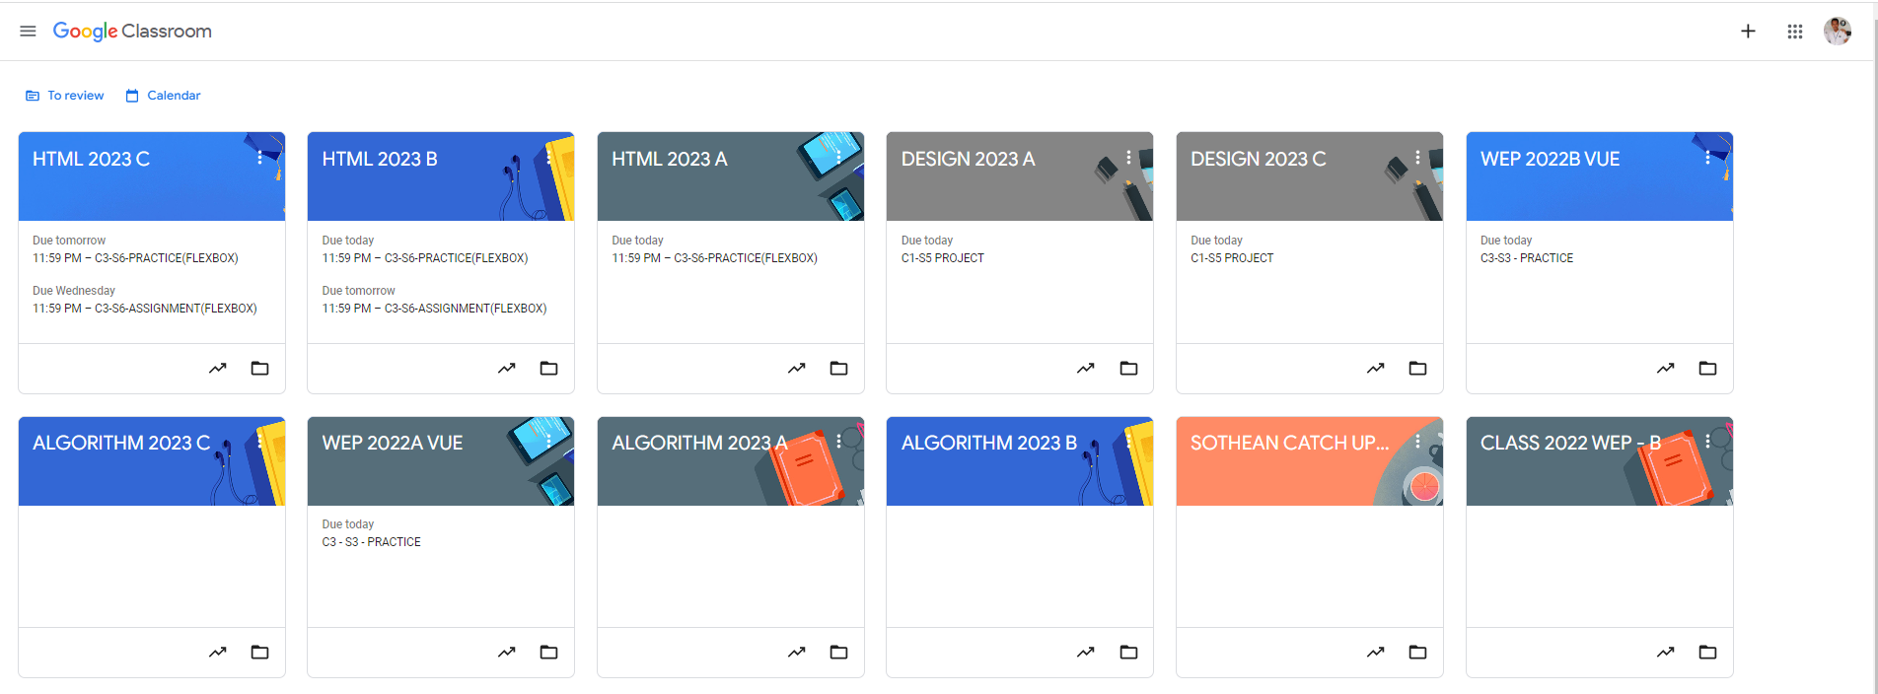
Root div
- Height: 100vh
content
nav
Flex: 0
header
Flex: 0
Flex: 1

